Slide 1
Introduction to Unsupervised Clustering
k-means, DBSCAN, and spectral
Alyssa W. Zhang
DRP Symposium
Spring 2024
Notes:
Hi everyone! I'm Alyssa and my DRP talk will be an introduction to unsupervised clustering. I will give an overview of the k-means, DBSCAN, and spectral clustering algorithms with lots of pictures.

Slide 2
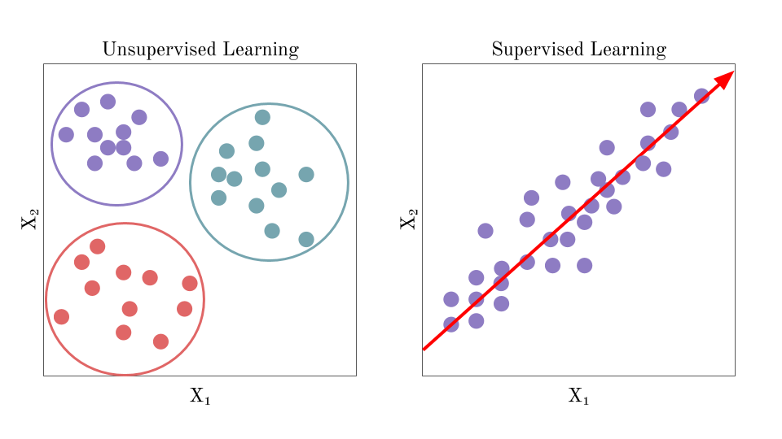
Unsupervised Learning
Supervised learning refers to learning from labeled data.
The objective is prediction or inference.
Regression and classification are forms of supervised learning.
Unsupervised learning refers to learning from unlabeled data.
The objective is to “create” labels by grouping data based on similarity.
Clustering is a form of unsupervised learning.
Notes:
In the world of data science, we can categorize tasks as either supervised or unsupervised learning. Supervised learning deals with labeled data, with the objective of prediction or inference. A form of this is regression.
Unsupervised learning deals with unlabeled data, with the objective of "creating" labels by grouping data based on similarity. A form of this is clustering.

Slide 3
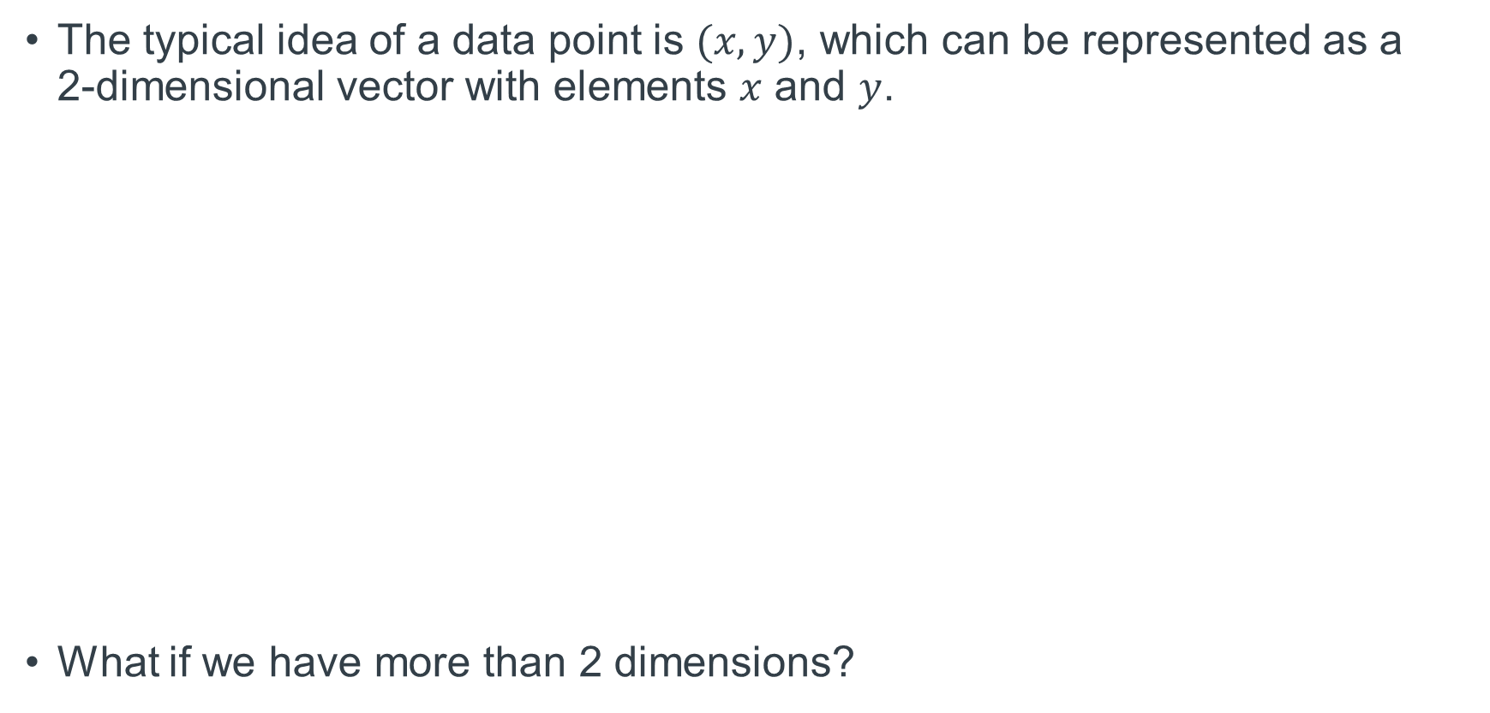
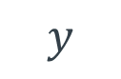
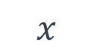
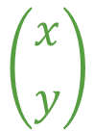
Data as High-Dimensional Vectors
The typical idea of a data point is $(x,y)$, which can be represented as a 2-dimensional vector with elements $x$ and $y$.
What if we have more than 2 dimensions?
$$\left({x \atop y}\right)$$
$$x$$
$$y$$
Notes:
Before getting into the nitty-gritty of clustering, we need to understand data as high-dimensional vectors. Our typical idea of a data point is (x,y), which we can very easily conceptualize as a 2-dimensional vector with elements x and y. But what if we have more than 2 dimensions?

Slide 4
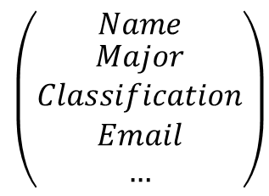
Data as High-Dimensional Vectors (cont.)
Suppose we have a large dataset on UT Austin students with names, majors, classifications, emails, and 100 other features.
We can represent each data point as a high-dimensional vector, where each vector element represents a feature.
Name | Major | Classification | Email | …
Zhang, Alyssa | Mathematics | Senior | ***@utexas.edu | …
Duncan, Addie | Mathematics | Graduate | ***@gmail.com | …
… | … | … | … | …
$$\left({Name \atop \begin{aligned}Major \\ Classification \\ Email \\ …\end{aligned}}\right)$$
Notes:
Suppose we have a large dataset on UT Austin students with names, majors, classifications, emails, and 100 other features. We can represent each data point as a high-dimensional vector in which each vector element represents a feature. In our example, each student would be represented by a high-dimensional vector like this in the corner.

Slide 5
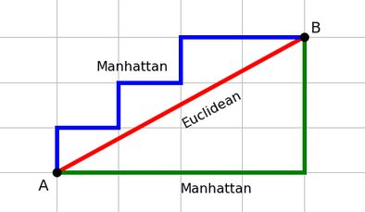
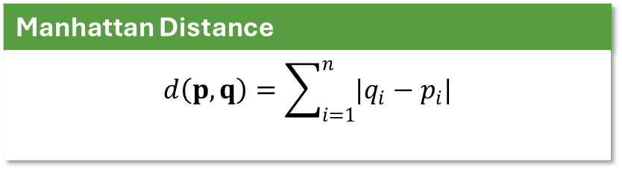
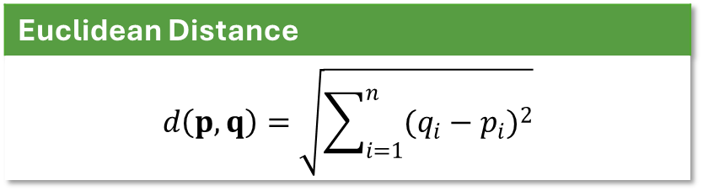
Measures of Similarity
Distance metrics are used to measure similarity between high-dimensional vectors (data points).
Because there are various ways of measuring distance, there are various methods of clustering―each with their own benefits and drawbacks.
Euclidean Distance
$$d\left(p, q\right)=\sqrt{\sum_{i=1}^{n}{{(q_{i}−p_{i})}^{2}}}$$
Manhattan Distance
$$d\left(p, q\right)=\sum_{i=1}^{n}{|q_{i}−p_{i}|}$$
Notes:
Distance metrics are used to measure similarity between vectors. There are various ways of measure distance. Most of us are familiar with Euclidean distance, which is calculated by taking the square root of the sum of the squared distances between corresponding vector elements. There's also Manhattan distance, which is calculated by finding the sum of the absolute value of the distances between corresponding vector elements. This picture here shows a 2-dimensional representation of Euclidean and Manhattan distance. Because there are various ways of measuring similarity, there are various methods of clustering--each with their own pros and cons.

Slide 6
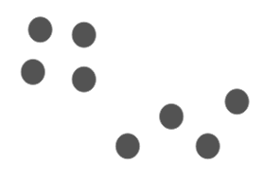
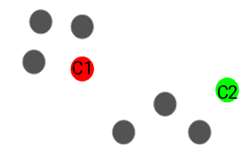
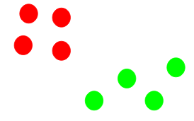
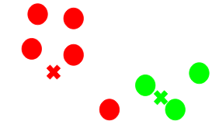
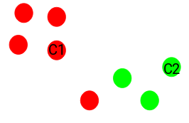
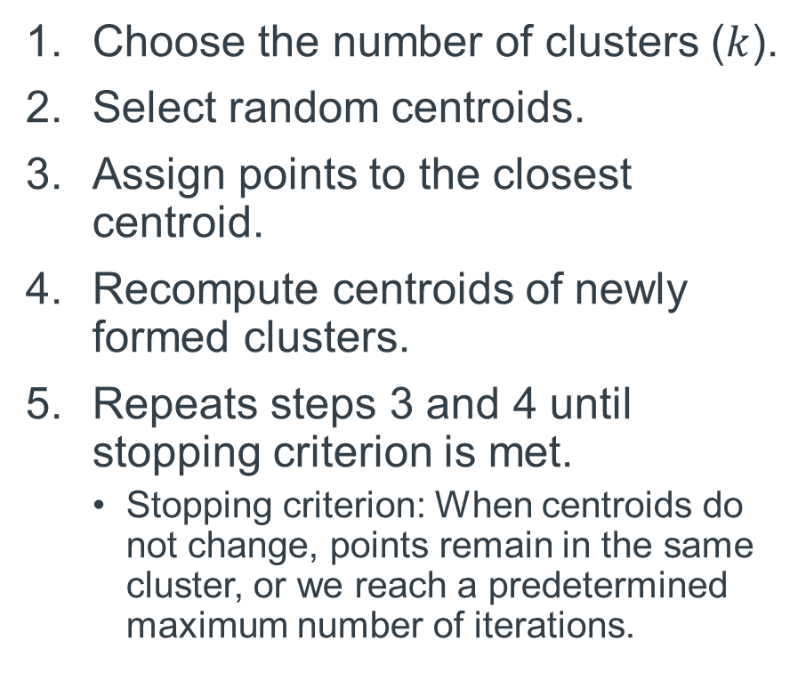
$k$-means Clustering Algorithm
Choose the number of clusters ($k$).
Select random centroids.
Assign points to the closest centroid.
Recompute centroids of newly formed clusters.
Repeats steps 3 and 4 until stopping criterion is met.
Stopping criterion: When centroids do not change, points remain in the same cluster, or we reach a predetermined maximum number of iterations.
Notes:
k-means is a centroid-based method of clustering. The first step in the k-means algorithm is to choose the number of clusters k; for our example, k is 2. The second step is to select random points as centroids (click); here we have randomly chosen this red point as centroid 1 and this green point as centroid 2. The third step is to assign points to the closest centroid (click). Then we recompute the centroids of our new clusters (click). We repeat steps 3 and 4 until a stopping criterion is met, which can be when the centroids don't change, the points remain in the same cluster, or we reach a predetermined maximum number of iterations.

Slide 7
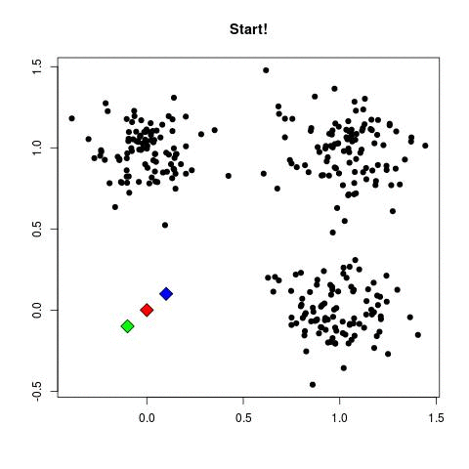
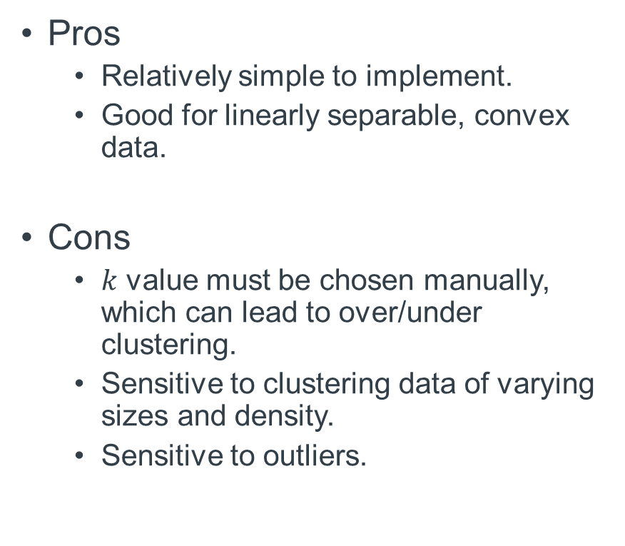
$k$-means Clustering Pros and Cons
Pros
Relatively simple to implement.
Good for linearly separable, convex data.
Cons
$k$ value must be chosen manually, which can lead to over/under clustering.
Sensitive to clustering data of varying sizes and density.
Sensitive to outliers.
Notes:
Some pros of k-means clustering are that it is relative simple to implement and good for linearly separable, convex data. Linearly separable means that the data has clusters that can be separated by straight lines. Convex data have clusters shaped like this (draw), of which I cannot draw a line that passes its edge more than twice; while non-convex data have clusters shaped like this (draw), of which I can draw a line that passes its edge more than twice.
Some cons of k-means clustering are that k must be chosen manually, which can lead to over or under clustering. One way to combat this is to make sure each cluster's inertia, which is the sum of distances of the points within a cluster from the centroid of that cluster, is low. Other cons are that it is sensitive to outliers and clustering data of varying sizes and density.

Slide 8
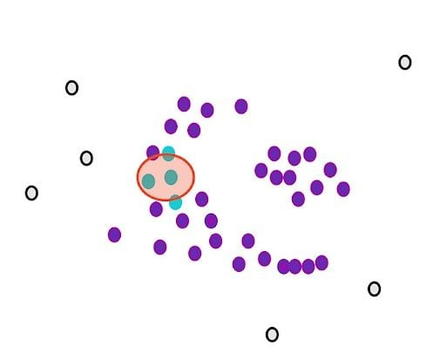
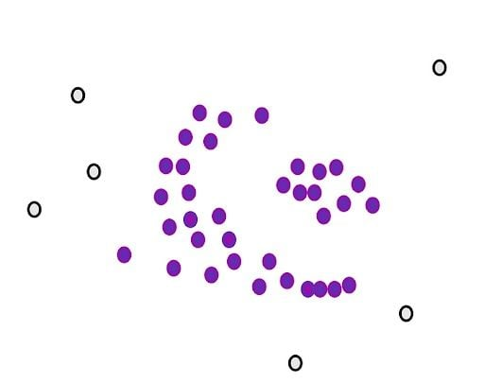
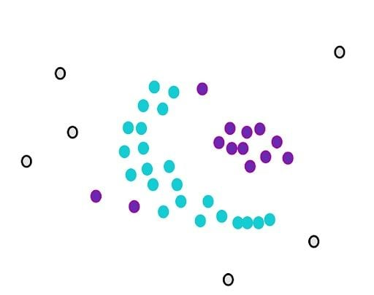
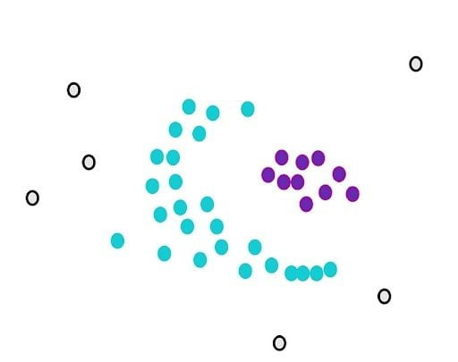
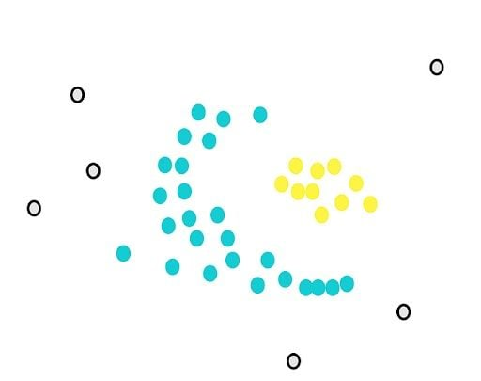
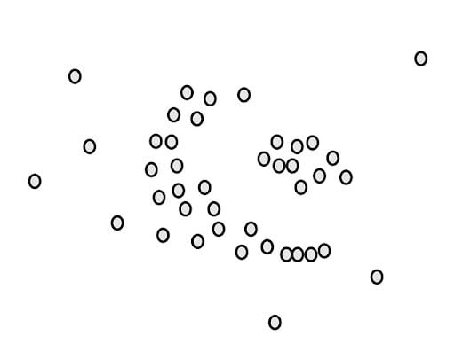
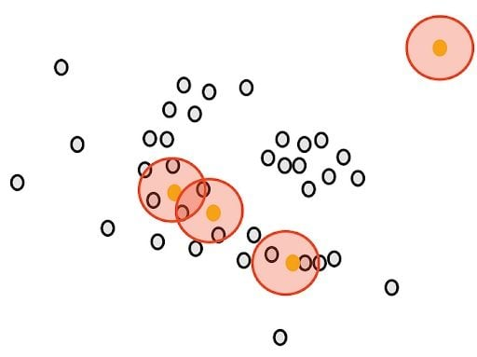
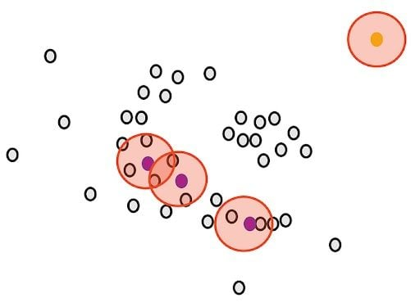
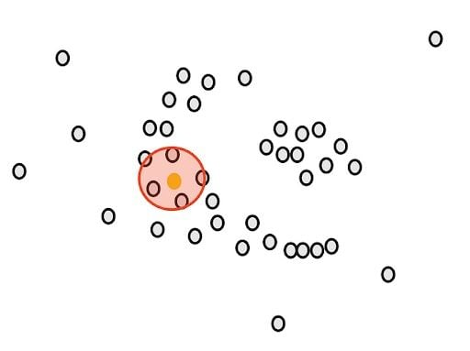
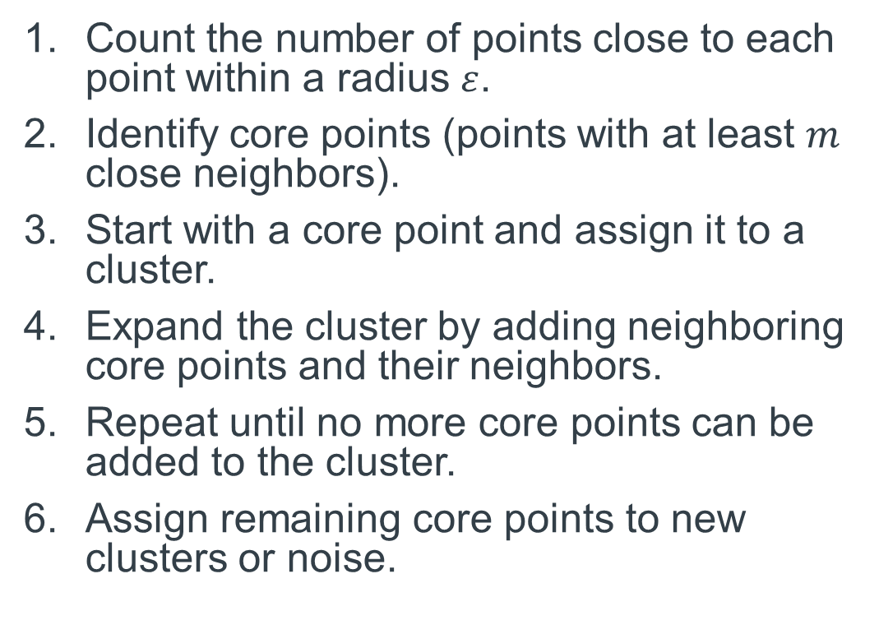
DBSCAN Clustering Algorithm
Count the number of points close to each point within a radius $ε$.
Identify core points (points with at least $m$ close neighbors).
Start with a core point and assign it to a cluster.
Expand the cluster by adding neighboring core points and their neighbors.
Repeat until no more core points can be added to the cluster.
Assign remaining core points to new clusters or noise.
Notes:
Next we have DBSCAN, which is a density-based clustering method. The first step is to count the number of points close to each point within a radius epsilon (click); so for example here this yellow point with a circle of radius epsilon around it has 5 close points. The second step is to identify core points, which are points with at least m close neighbors (click); see these yellow points here, if we were to set m as 3, (click) these ones in purple would be considered core points because they all have at least 3 neighbors while this one still in yellow would be considered an outlier because it has less than 3 neighbors (click); here in purple are all the core points. The third step is to start with a core point and assign it to a cluster (click). Next we expand the cluster by adding neighboring core points and their neighbors (click). We repeat this until no more core points can be added to the cluster (click). Lastly, we assign the remaining core points to new clusters or noise. So here we have in yellow and cyan two clusters, with everybody else considered outliers or noise.

Slide 9

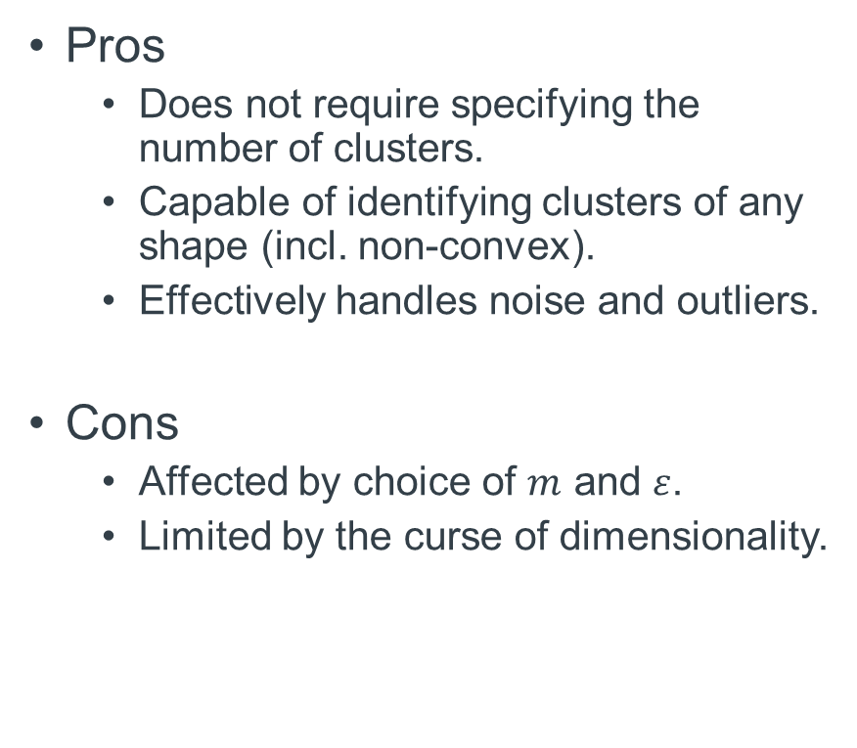
DBSCAN Pros and Cons
Pros
Does not require specifying the number of clusters.
Capable of identifying clusters of any shape (incl. non-convex).
Effectively handles noise and outliers.
Cons
Affected by choice of $m$ and $ε$.
Limited by the curse of dimensionality.
Notes:
Some benefits of DBSCAN are that it does not require specifying the number of clusters. It is also capable of identifying cluster of any shape, and handling noise or outliers.
One drawback of DBSCAN is that it is affected by choice of m and epsilon. Varying m and epsilon would lead to drastically different clustering results. Another drawback is that DBSCAN is limited by the curse of dimensionality.

Slide 10
Concepts for Spectral Clustering
Curse of dimensionality refers to various phenomena that occur with data in high-dimensional spaces that does not occur in low-dimensional spaces.
For sufficiently large dimensions, the distances between all pairs of data points will be essentially the same.
When distances between all pairs of data points are the same, DBSCAN may merge all points into the same cluster.
Situation would benefit from projecting data to a lower-dimensional subspace.
Notes:
The curse of dimensionality refers to various phenomena that occur with data in high-dimensions that does not occur in low-dimensions. One such phenomenon is that for a sufficiently high dimensions, the distances between all pairs of data points become essentially the same. So for DBSCAN this would mean that all points would be merged into the same cluster. In situations like this, we may benefit from projecting data to a lower dimensional subspace so that distances vary.

Slide 11
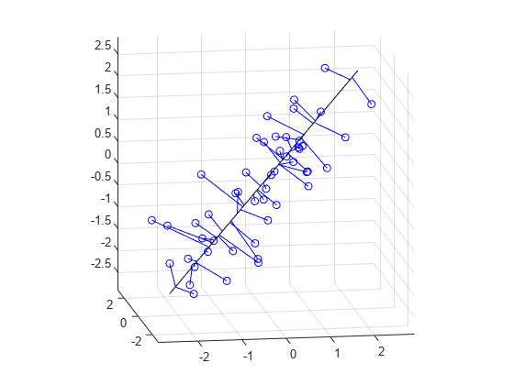
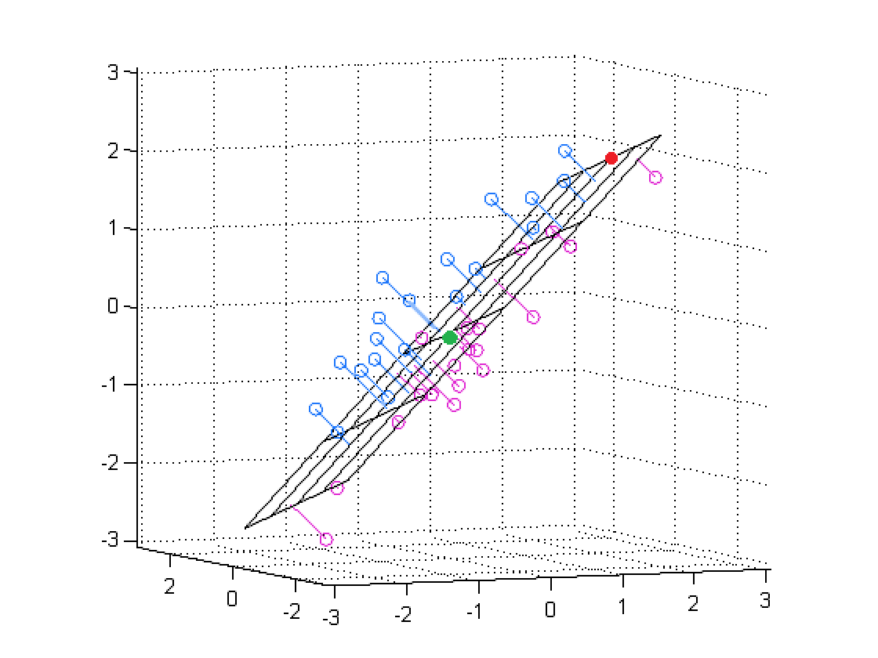
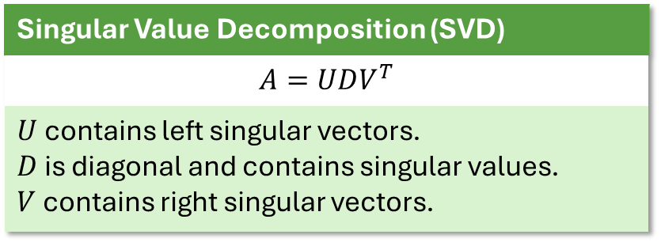
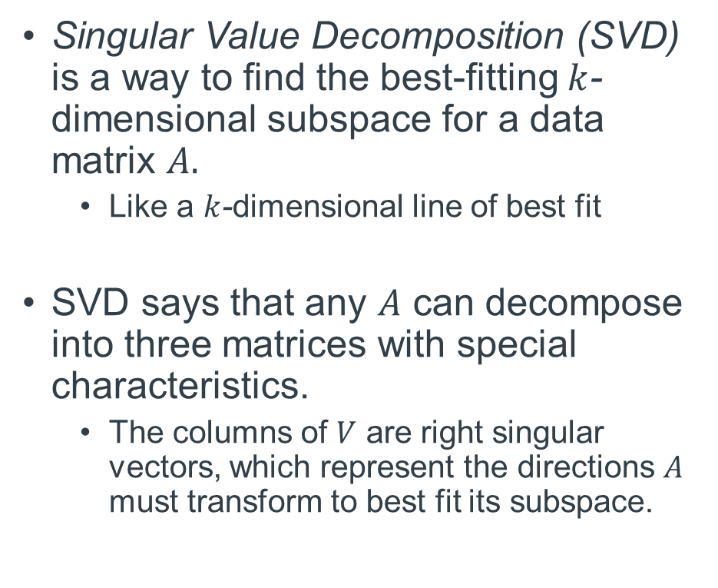
Concepts for Spectral Clustering
Singular Value Decomposition (SVD) is a way to find the best-fitting $k$-dimensional subspace for a data matrix $A.$
Like a $k$-dimensional line of best fit
SVD says that any $A$ can decompose into three matrices with special characteristics.
The columns of $V$ are right singular vectors, which represent the directions $A$ must transform to best fit its subspace.
Singular Value Decomposition (SVD)
$$A=UDV^{T}$$
$U$ contains left singular vectors. $D$ is diagonal and contains singular values. $V$ contains right singular vectors.
Notes:
Singular Value Decomposition, or SVD, is a method that can be used to find such a lower dimensional subspace. Suppose we have a data matrix A, which contains all the high-dimensional vectors representing our data. SVD says that any data matrix A can be decomposed into three matrices, represented here as U, D, and V transpose. These three matrices have special properties. In particular, the columns of V are right singular vectors, which represent the directions A should stretch or compress to best fit its subspace.

Slide 12
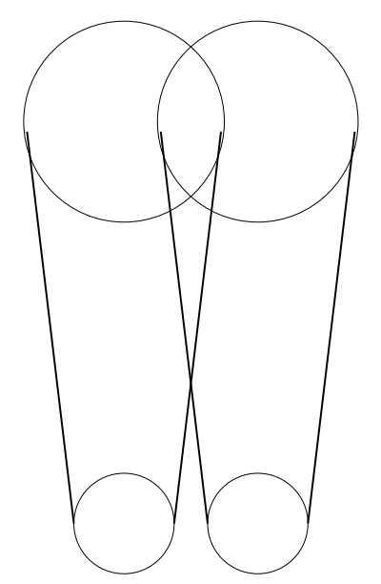
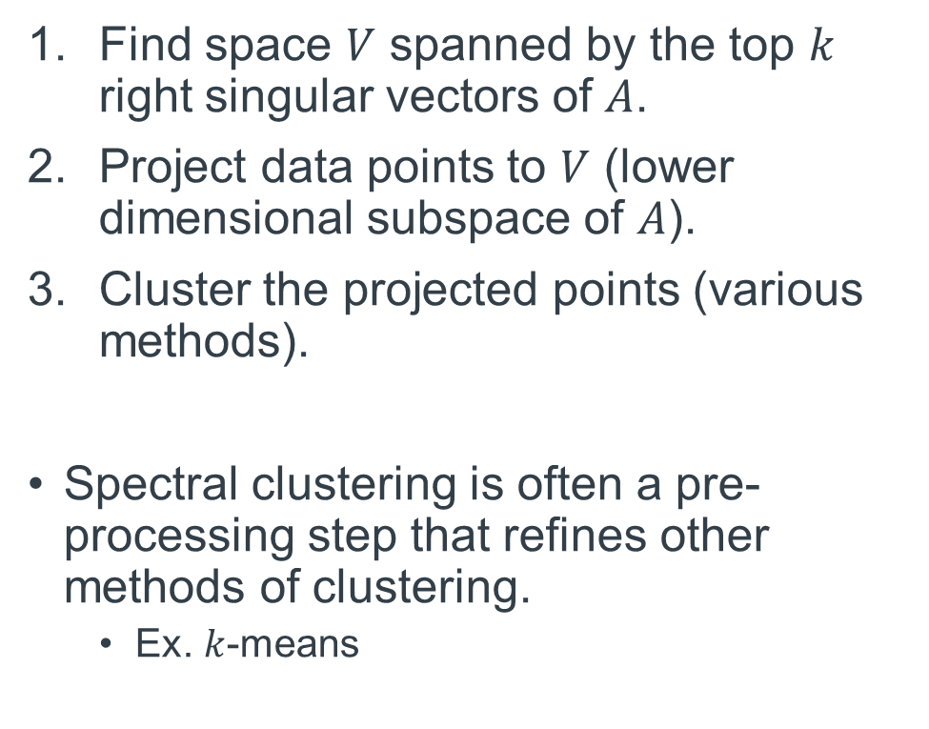
Spectral Clustering Algorithm
Find space $V$ spanned by the top $k$ right singular vectors of $A$.
Project data points to $V$ (lower dimensional subspace of $A$).
Cluster the projected points (various methods).
Spectral clustering is often a pre-processing step that refines other methods of clustering.
Ex. $k$-means
Notes:
Spectral is a method of clustering that avoids the curse of dimensionality and can be understood through the application of SVD. The first step of spectral clustering is to find a space V spanned by the top k right singular vectors of A. Second, we project data points to V, which is a lower dimensional subspace of A. Then we would cluster the project points using whichever method we deem suitable.
Spectral clustering is often a pre-processing step that refines other methods of clustering. For example, k-means is method that benefits from spectral clustering. At the top of this picture here, we see that before projection we have 2 clusters with a lot of overlap; since k-means is unsuitable for non-linearly separable data, it may not be able to identify the 2 clusters correctly. At the bottom of this picture here we see that after projection linear separability is introduced, thus allowing k-means to work better.

Slide 13
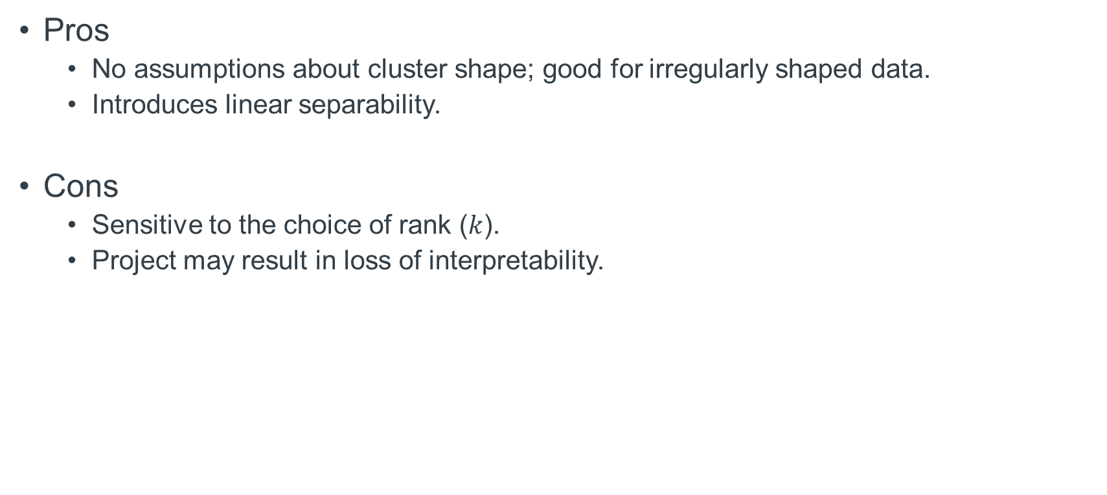
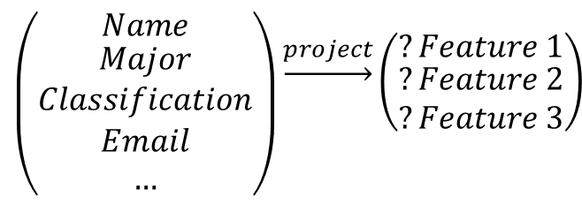
Spectral Clustering Pros and Cons
Pros
No assumptions about cluster shape; good for irregularly shaped data.
Introduces linear separability.
Cons
Sensitive to the choice of rank ($k$).
Project may result in loss of interpretability.
$$\left({Name \atop \begin{aligned}Major \\ Classification \\ Email \\ …\end{aligned}}\right)\underset{→}{project}\left({?Feature 1 \atop \begin{aligned}?Feature 2 \\ ?Feature 3\end{aligned}}\right)$$
Notes:
Some advantages of spectral clustering is that is makes no assumptions about cluster shape, so it is good for irregularly shaped data. It also introduces linear separability.
Some drawback are sensitivity to choice of rank and possible loss of interpretability. For instance, if we were to project a vector from our previous example’s UT Austin student dataset to a 3-dimensional space, we might not understand what our 3 new features mean.

Slide 14
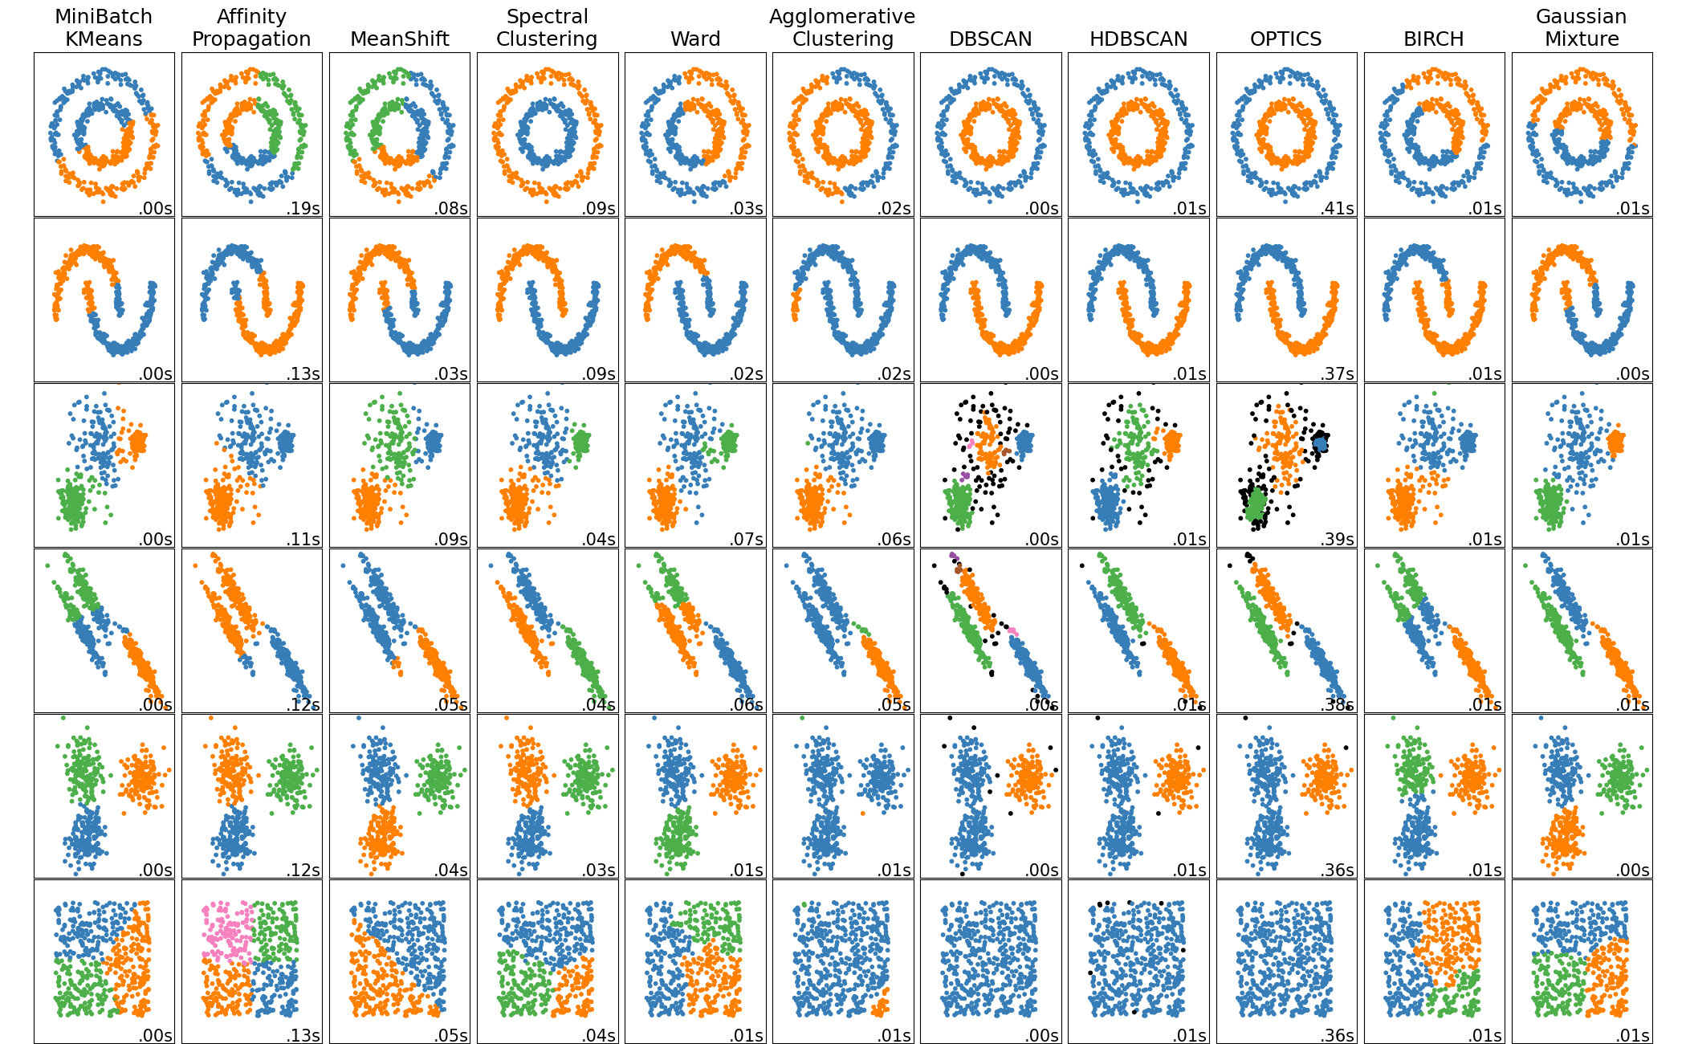
Visual Comparison
Notes:
Here is a visual comparison of the three clustering methods we talked about. In the first two rows on the left, it's obvious that DBSCAN and Spectral do much better than k-means when data is nonconvex. The black and purple points in some of the DBSCAN visuals show how the method is great for identifying noise and outliers. The first row on the right shows how k-means has trouble with irregular convex shapes. The bottom right row highlights how DBSCAN benefits from not having to manually decide a number of clusters.

Slide 15
Visual Comparison (cont.)
Notes:
In this talk we have gone over 3 types of clustering, but actually there are many more different methods, each great for some datasets and not-so-great for others.

Slide 16
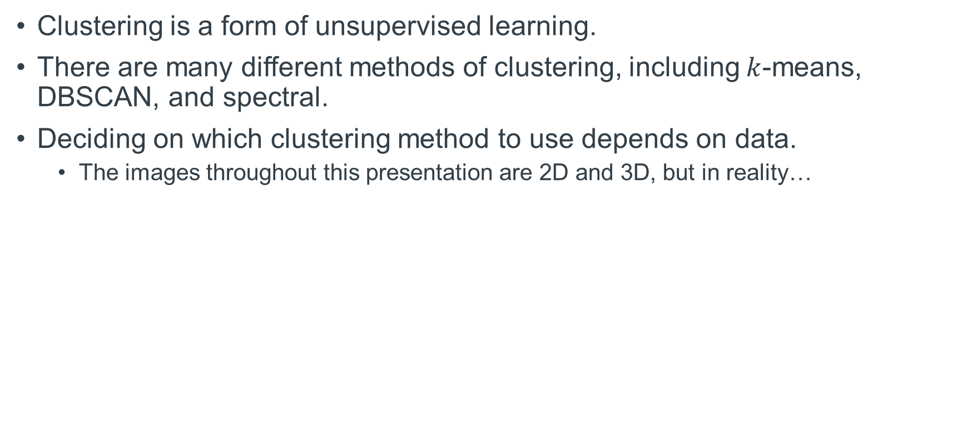
Summary
Clustering is a form of unsupervised learning.
There are many different methods of clustering, including $k$-means, DBSCAN, and spectral.
Deciding on which clustering method to use depends on data.
The images throughout this presentation are 2D and 3D, but in reality…
Notes:
In summary, we have learned today that clustering is a form of unsupervised learning. There are many different methods of clustering, including k-means (which is centroid based), the DBSCAN (which is density based), and the spectral (which involves projection). Deciding on which clustering method to use depends of the shape of data. In this presentation, we used a lot of pictures of visualize shapes in 2D and 3D. But in reality, high-dimensional data cannot be easily visualized so deciding on clustering method is a complex process.

